Slide 1

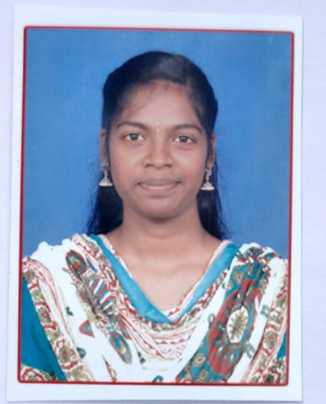



S Ilavarasi
Education and certificates Bachelor of Engineering, Electronics and Communication Engineering : 2015-2019
Skills
Analyst/Software Engineer
Base Location: Tamil Nadu
Email ID: ILAVARASI.S@CAPGEMINI.COM
Mobile No: 9087045534
Grade: A4
Spring | Spring Boot , Spring Rest Services
Web Technologies | HTML CSS JavaScript Bootstrap
Database | postgre SQL
Tools | Git & GitHub, Eclipse, STS Postman , Visual Studio Code, pg Admin 4.
Back End | Node.js.
Add on Skills | Immersive Learning and Java
Additional Skills | Innovative Thinking Attention to Detail Teamwork Initiative-Driven
Strengths
Full Stack Developer
Hands on experience on Core java, postgre-SQL, Spring Restful Services.
Proficient in creating Single page Web Application in Angular with Authentication and routing
Good understanding of developing new Controller and Entity classes in Spring.
Hands on experience in developing web pages using HTML, CSS , JavaScript.
Ready to learn new technologies and implement them for the Future Knowledge.
Achievement
INTERVIEW TRACKING SYSTEM
Case study of Interview Tracking System along with API Gateway, Postman, responsive UI with HTML, CSS, Bootstrap and Angular used as User Interface.
Degreed :Successfully completed the degreed training in git, Jenkins , Agile and Angular
Check out my work on GitHub
Presentation Title | Author | Date © Capgemini 2017. All rights reserved | 1

